Slide 1
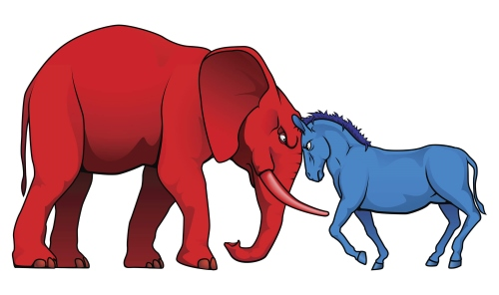
US Political Polarity
AJ Marcus

Slide 2
Politics has become a large societal concern in the United States and the polarizing stances on common issues has given way to social unrest, tension, and distrust.
The goal here is to validate the existence, primary actors, and timeline of political polarity as a baseline for future analysis.

Slide 3
Report Outline
Data Source
Hypothesis
Methodology
Predictions
Data Sources
Primary Source is the Congressional Session and Membership Voting from VoteView.com
Supplemental data compiled from various historical event archives including Library of Congress, White House media relations, and public news feeds.

Slide 4
Report Outline
Data Source
Hypothesis
Methodology
Predictions
Hypothesis
First Phase: The current polarization of political parties exists prominently in Congress; determine occurrence timeline and scale
Second Phase: Current polarization can be identified through each facet of Congressional body, Presidential administration, and neighboring Congressional sessions.

Slide 5
Report Outline
Data Source
Hypothesis
Methodology
Predictions
Methodology
Use statistical tests to determine confidence outcomes
No assumption of parametric distributions
Validate segment results against similar analysis
Determine feasibility of data use in voting prediction models

Slide 6
Report Outline
Data Source
Hypothesis
Methodology
Predictions
Predictions
US Politics will show polarization beginning in 1970s
Congressional nominate scores will align with Presidential Administration
Member votes will align with Party regardless of Congressional disposition

Slide 7

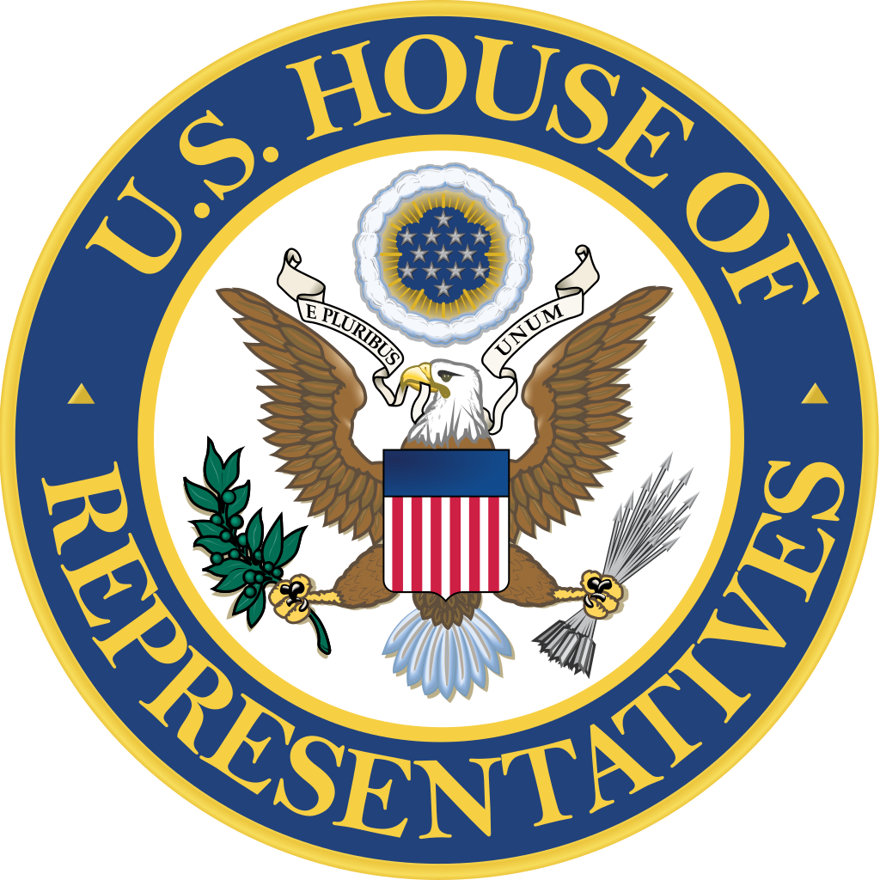
Considerations
Party definitions and dimensions change over time
Nominate scores are based on observed confidence values
Assumes Congress samples the Country’s dispositions
PROS
Data source is established and consistent
Source is population data, not sampling
Peer reports validate the nominate statistic on multiple fronts
CONS

